Slide 1
MY PLAN
Supporting the graduated approach And the eHCar

Slide 2
What is My Plan?
My Plan is a toolkit that helps implement the graduated approach to support children and young people with SEN.
My Plan is a new universal way for all settings to record this information in a format that is jargon free and dovetails in with the Single Assessment used in North East Lincolnshire.
My Plan puts the child at the centre of SEN decision making. It records how the pupil themselves would like to be supported and what goals or outcomes they are working towards.
My Plan also records what the family, setting or other adults supporting your child may be worried about, what is working well, and what needs to happen next.
My Plan makes it easier if pupils move schools and help parents to be familiar with just one style of recording and reporting for their children.

Slide 3
What is My Plan?
6.44 Where a pupil is identified as having SEN, schools should take action to remove barriers to learning and put effective special educational provision in place. This SEN support should take the form of a four-part cycle through which earlier decisions and actions are revisited, refined and revised with a growing understanding of the pupil’s needs and of what supports the pupil in making good progress and securing good outcomes. This is known as the graduated approach. It draws on more detailed approaches, more frequent review and more specialist expertise in successive cycles in order to match interventions to the SEN of children and young people.
SEND Code of Practice: 0 to 25 years

Slide 4
Example My Plan

Slide 5
Example My Plan
NOTE:
All 3 Cycles of the My Plan are colour coded
Cycle 1 – BLUE
Cycle 2 – YELLOW
Cycle 3 - GREEN

Slide 6
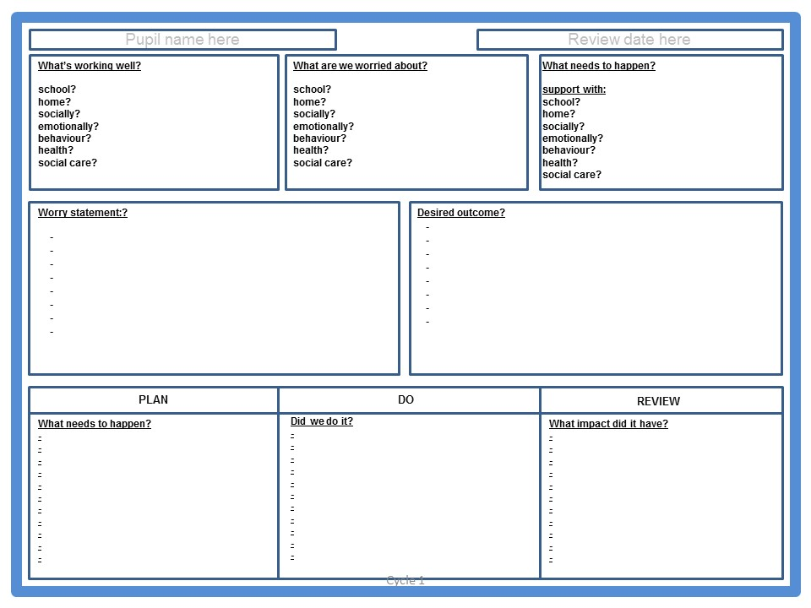
Example My Plan

Slide 7
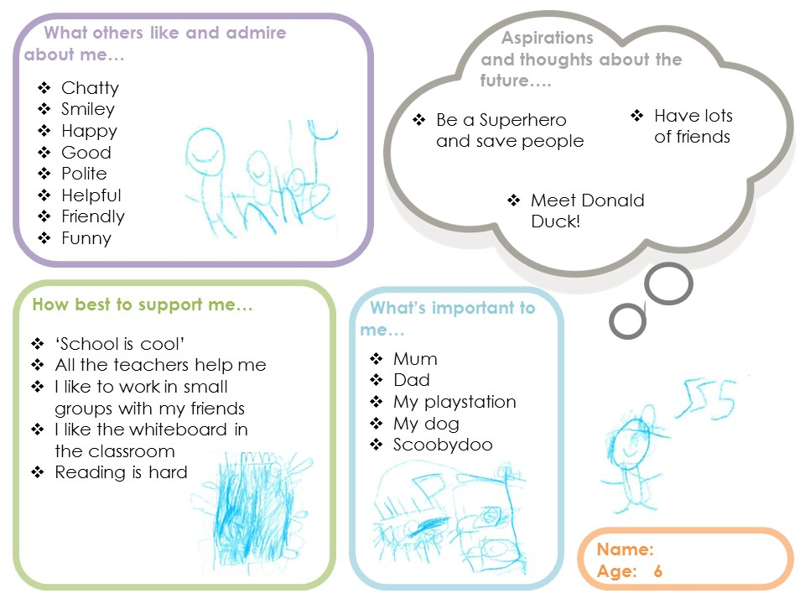
Example EYFS and Primary School One Page Profile

Slide 8
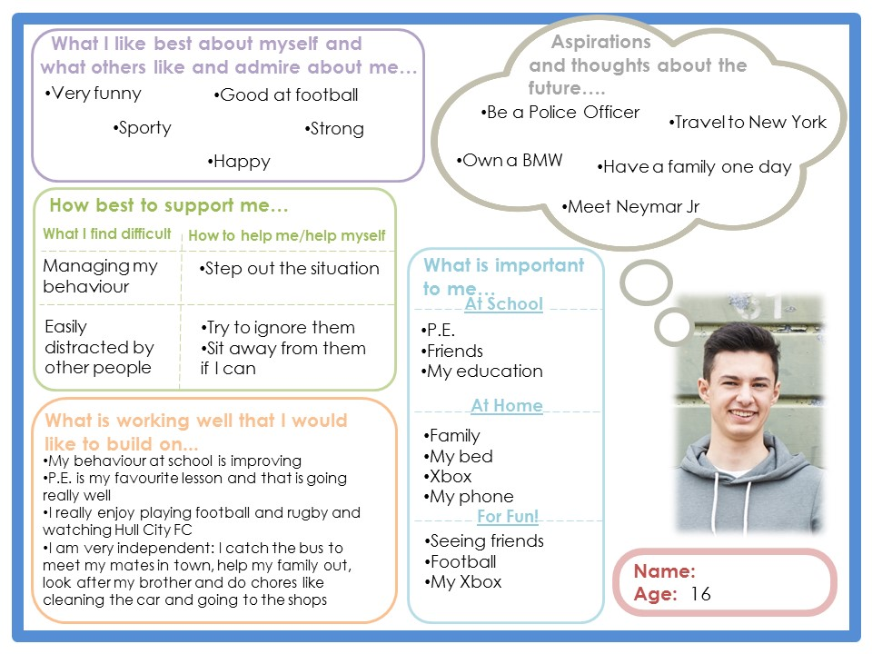
Example Secondary School and FE One Page Profile

Slide 9
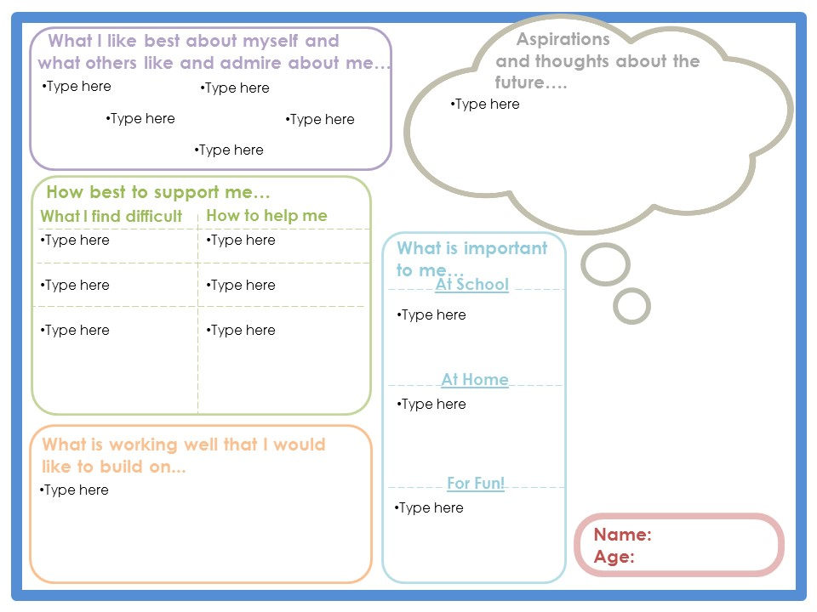
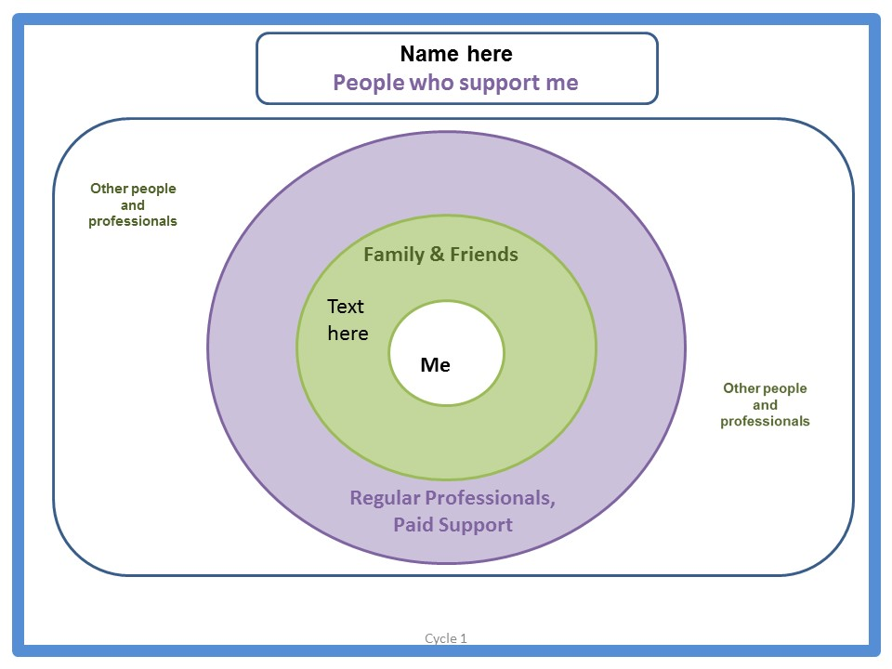
Example My Plan
Miss Smith my TA
Nan
Mum
Dad
Zak
Millie
My dog Buster
My piano teacher

Slide 10
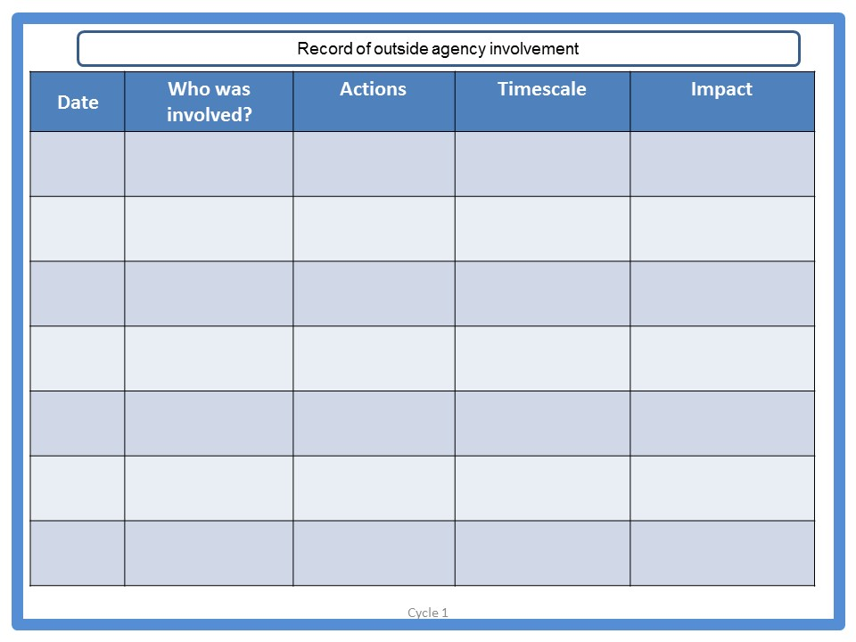
Example My Plan

Slide 11
How to deliver it?
1
School identify children who need SEN support and then begin My Plan process
2
School to arrange a meeting with parents to gain their views for cycle 1
of the My Plan
3
School to work with each child to create a person centred One Page Profile and complete a Relationship Circle
4
Both the parents views and the child’s One Page Profile and Relationship Circle are recorded electronically on the My Plan document
5
School to arrange a meeting with parents and relevant professionals to discuss and create the worry statement and desired outcomes and then agree on next steps which are recorded in the PLAN, DO and REVIEW section of the My Plan document

Slide 12
How to deliver it?
6
S School to implement the agreed actions and strategies recorded in the plan and document how this is working/not working
7
School to arrange a meeting with parents and relevant professionals if necessary to review whether the desired outcome was met and how to move forward
8
If the desired outcome is not achieved move onto cycle 2 and repeat the process again for cycle 3 if necessary
9
If after 3 cycles the desired outcome has not been met – the My Plan can be used as evidence to support an EHCAR (EHC assessment request)

Slide 13
How Core Assets can support with the My Plan Process

Slide 14
Any Questions?

