Slide 1
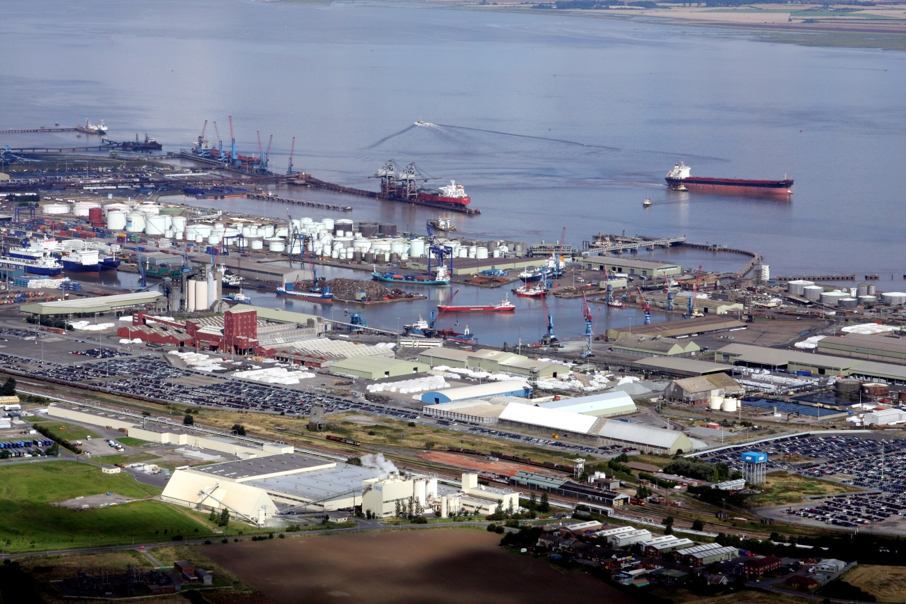

NELC Budget Summary 2018/19 & Medium Term Financial Plan 2018/19 to 2020/21

Slide 2
Contents
Introduction Page 2
Director of Finance Overview Page 3
Where the Money Comes From Page 4
Council Tax Requirement Page 5
Medium Term Financial Plan Page 6
Reserves & Balances Page 9
Capital Programme Page 12
2017/18 Revenue Budget Page 16
1

Slide 3
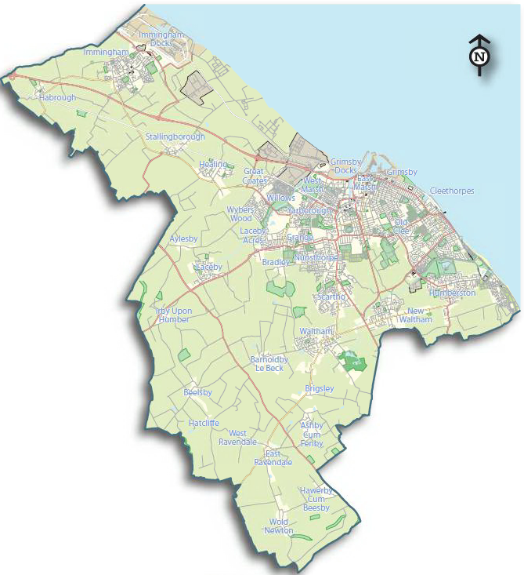
Introduction
This document sets out North East Lincolnshire’s Revenue budget for 2018/19 in a summarised format, together with the Medium Term Financial Plan for 2018/19 to 2020/21.
Full Council agreed the budget on the 1st March 2018. This report includes summary of the opening budget for 2018/19 with other information regarding the funding of the overall budget, and the way in which the Council Tax is set. It also contains the Capital Programme which runs up until 2020/21, and information relating to the Councils Reserves and Balances. Finally it details for each directorate the main components of the directorate budget, as well as narrative that explains which services it provides.
The information contained within this document is to help assist the Public, Members, Chief Officers and their staff in understanding the current financial position and in preparing for future budgets
2

Slide 4
Director of Finance Overview
This Outcomes Framework, Commissioning Plan and Budget outlines in detail how the Council plans to deliver its agreed financial strategy over the coming three year period. The document focuses on the delivery of core services at the same time as outlining how we are investing for the future and becoming more commercial as an organisation.
The Council has seen significant reductions in its funding since 2010 and this has required activities to be refocused in order to deliver a balanced budget position. The commissioning approach has ensured that we focus upon key outcomes and deliver services in the most efficient, effective, equitable and sustainable way. Indeed, this approach has required the Council to take bold decisions and actively manage risk and opportunity as it arises. The proportion of funding we receive from Government will reduce further over the next three years and the Council needs to adapt to a changing business model for the local government sector. The move towards local generation of funding through growing both the Council Tax and Business Rate base to generate more income, will help to drive financial sustainability for the Borough as a whole.
The Council has demonstrated its commitment to the achievement of long term growth and financial sustainability with its recent successful ‘Town Deal’ submission. The deal represents a transformative approach to working in partnership with Government and major private investors to accelerate economic and housing growth across North East Lincolnshire. The deal will make a significant contribution to the Council’s strategic objective of enabling the growth of a strong and sustainable local economy to deliver the major projects identified in the Council’s Local Plan submission and Economic Strategy. This will include major projects at the Port of Immingham, Stallingborough Enterprise Zone and town centres. In support of our economic ambitions, the Council has set out its vision for a transition to a low carbon economy which builds on the success of the offshore wind sector and our position within the ‘Energy Estuary’. Energy is a commissioning priority for the Council and a key enabler to deliver against our priorities. These key investments within the local economy will need to be managed within a changing regulatory environment for local government, which requires increased transparency and clarity of decision making.
The Council has also entered into a innovative ‘Union’ arrangement with the North East Lincolnshire CCG which will lead to a more efficient and effective working relationship with the health sector and make best use of the range of skills and capacity in both organisations to make lasting changes. As the Union with the CCG develops, we will realise opportunities for closer joint working in areas such as commissioning, procurement, contract management, business support and finance.
In summary, despite the current financial pressures the Council remains committed to the achievement of long term financial sustainability by embracing the area’s economic potential and by budgeting for growth. This is the only way the Council can become self sufficient and generate the resources necessary to maintain and reinvest in quality public services.
Sharon Wroot, Director of Finance, Resources and Operations
3

Slide 5
Where North East Lincolnshire Council Funding Comes From 2018/19
Revenue Support Grant
£13.4m
Adult Social Care Precept & Support Grants £10.8m
Council Tax
£60.4m
Business Rates Retention £39.7m
Total NET Budget
£124.9m
New Homes Bonus £0.6m
The Revenue Support Grant (RSG) is revenue funding given to local Authorities by Central Government.
The funding is shared out between authorities on the basis of a population based distribution formula.
This includes additional 3% precept raised through Council Tax and specific grants from Central Government
Non-Domestic Rates, or business rates, collected by local authorities are the way that those who occupy non-domestic property (Shops, Bars & Restaurants etc.) contribute towards the costs of local services.
Authorities retain a proportion of the business rates collected locally.
The amount of Council Tax collectable is based upon the total value of taxable property (the tax base) and the agreed charge per band.
4

Slide 6
North East Lincolnshire Council 2018/19 Council Tax Requirement
To finalise its budget the Council must set a Council Tax requirement – the amount of money raised by Council Tax. The table below shows the Council Tax bills for North East Lincolnshire residents by property band. The band is based on the value of your property, and incudes the 1.98% increase from NELC, 3% increase for Adult Social Care Precept plus charges for Police, Fire and Parish Precepts
5

Slide 7
Medium Term
Financial Plan
2018/2019 – 2020/2021
6

Slide 8
North East Lincolnshire Council Medium Term Financial Plan
In order to set our revenue budget and build the Medium Term Financial Plan (MTFP) a number of factors are considered to ensure a balanced position can be achieved whilst working within defined budget envelopes for each area. Such factors include changes to funding levels, national and local intelligence, inflation rates, pay agreements and local demographics.
A number of specific assumptions are made in the MTFP position which are:
MTFP
An increase in Council Tax of 1.98%
Indexed inflation uplift on major contracts
Current agreed National Pay Award indications and 1% thereafter
No general or income inflation
Additional 3% Adult Social Care (ASC) Precept for 2018/19
Reduction in New Homes Bonus following announced changes to the scheme
7

Slide 9
8

Slide 10
Reserves & Balances
2018/2019 – 2020/2021
9

Slide 11
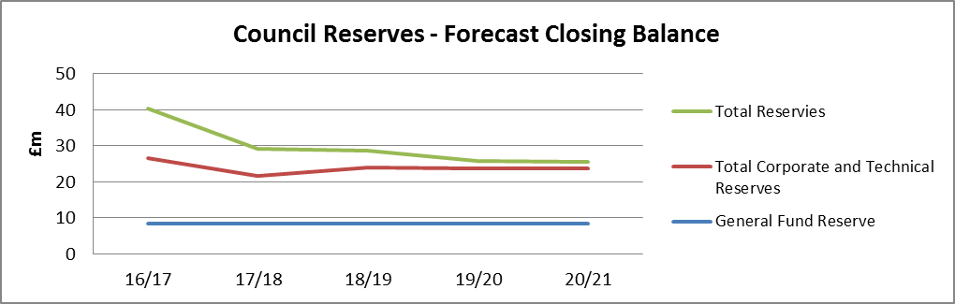
North East Lincolnshire Council Reserves & Balances
The MTFP is supported by reserves and general fund balances. Useable reserves are generally held for three specific purposes:
A working balance to help smooth the impact of uneven cash flows – General Reserves
A reserve to deal with unexpected events – General Reserves and some corporate reserves.
A means of building up funds to meet known or predicted requirements – Earmarked Reserves.
The Council’s reserve policy sets out the following key principles for the establishment and use of reserves:
The balance on the general reserve will be reviewed as part of the budget setting process
Earmarked Reserves will only be established to meet a defined purpose
Creation of new earmarked reserves will be approved by Cabinet.
Approval to utilise or top-up established reserves will be subject to the approval of the Section 151 Officer.
That unspent earmarked reserves at the end of each financial year will be reassessed and challenged, with a view to their release to fund greater priorities
As part of the financial planning process all reserves, general and earmarked, are reviewed in detail. The graph below shows the current forecast closing balance in each year of the financial plan and will be updated throughout the process.
10

Slide 12
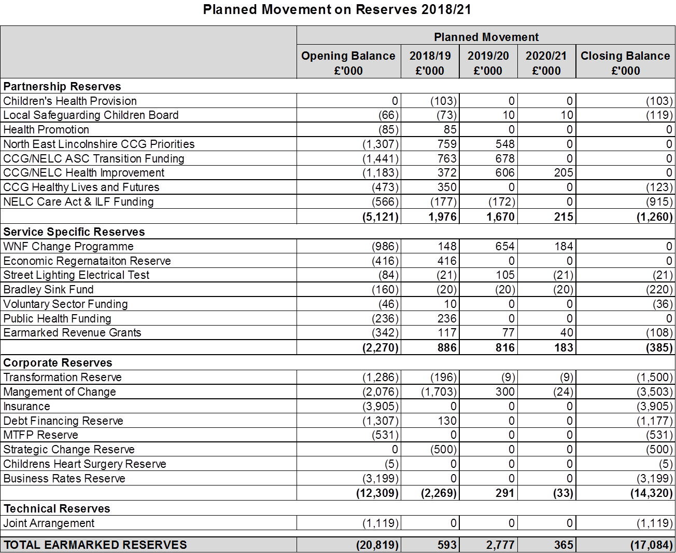
11

Slide 13
Capital Programme
2018/2019 – 2020/2021
12

Slide 14
North East Lincolnshire Council Capital Programme
The Council is keen to support longer term investment within the Borough to ensure that it delivers against its overall outcomes and ambitions. A key aspect of this approach will be to accelerate delivery by working in partnership with others rather than alone. The Council has already given a strong indication of its ambition through its support for the SHIIP programme and by enabling the Cartergate development. The latest success announced a Town Centre Pilot which will develop a new approach to regeneration that will be taken forward by public and private sector partners to revitalise the town centre, increase skill levels and create new jobs and housing.
There are also longer term plans in place to support housing growth and development within the Borough. Development will be accelerated through a variety of mechanisms; enabling support for major projects
such as Grimsby West, looking at strategic land assembly opportunities, intervening
and bringing brownfield sites back Into use, engaging with partner organisations
such as the Homes and Communities Agency and participating in
Wider asset rationalisation programmes such as One Public
Estate. All developments will be supported by sound and
robust business cases which consider both the risks and
opportunities available to the Council.
Increasing borrowing over and above the levels detailed within the
current capital programme borrowing should be in accordance with
prudential borrowing principles. Borrowing must be affordable,
sustainable and prudent. Schemes will need to be supported
by a robust business case which demonstrates payback over
the life of the project and which would justify additional
borrowing and revenue cost.
As part of the Government review of the Prudential Framework
local authorities will need to be better at explaining why, not just
what they are doing with their investment activity, needing to
demonstrate more transparency and openness in how good governance
and democratic accountability have been exercised.
Total Capital Programme Funding £50.5m
Capital Receipts £3m
Non Ring-Fenced Grants £8.4m
Prudential Borrowing £24.6m
Ring-Fenced Grants
£13.5m
Private Sector Contribution £0.5m
Specific Loans (SALIX)
£0.5m
13

Slide 15
14

Slide 16
15

Slide 17
Revenue Budget
2018/2019 – 2020/2021
16

Slide 18
North East Lincolnshire Council Revenue Budget
Council Wide Budgets Page 19
Chief Executive Directorate Page 21
Economy & Growth Page 26
Resources Page 25
Shared Services Page 28
Governance & Democracy Page 29
Early Intervention Page 34
Children's Services Page 35
Law Page 30
Deputy Chief Executive Directorate Page 31
Corporate Budgets Page 38
Adult Services Page 37
Environment Page 24
Public Health Page 36
17

Slide 19
North East Lincolnshire Council Revenue Budget
The information set out in this section is presented in two ways. The first is objectively; which is based around department expenditure and then broken down into services and teams. The second presentation of data is subjectively; where expenditure and income is presented by the type of expenditure or income. The categorisation of this expenditure is explained as follows:
Expenditure
Employees |  | Pay related items, including salaries, training and recruitment Note: FTE numbers are budgeted figures and may not be representative of the actual number of employees
Premises |  | Items relating to buildings including, utility bills, repairs and maintenance, and rents
Transport |  | Costs of vehicles including maintenance, fuel bills and SEN transport
Supplies & Services |  | The cost of equipment, contracts etc.
Third Party Payments |  | Payments that the council makes to other companies/authorities for services carried out on our behalf
Transfer Payments |  | Payments we make on behalf of others e.g. Housing Benefits
Support Services |  | Accounting recharge entry, where rechargeable support service departments carry out work and requires reimbursement
Capital Financing Costs |  | Revenue expenditure that is to be spent/related to the capital programme
Income
Government Grants |  | Grants that we receive from central government
Other Grants & Contributions |  | Income received from other authorities or bodies
Customer & Client Receipts |  | Income generated from sales and providing services and regulation
Interest |  | Interest received in respect of bank investments
Recharges |  | Accounting recharge entry, where rechargeable support service departments carry out work and requires reimbursement
Miscellaneous Income |  | Any other type of income
Investment Income |  | Interest received in respect of loans
Credits from Soft Loans |  | Interest received in respect of soft loans
18

Slide 20
Council Wide Budgets
19

Slide 21
20

Slide 22
Chief Executive Directorate
21

Slide 23
22

Slide 24
23

Slide 25
24

Slide 26
25

Slide 27
26

Slide 28
27

Slide 29
28

Slide 30
29

Slide 31
30

Slide 32
Deputy Chief Executive Directorate
31

Slide 33
32

Slide 34
33

Slide 35
34

Slide 36
35

Slide 37
36

Slide 38
37

Slide 39
Corporate Budgets
38

Slide 40
39

Slide 41
40

