Slide 1
Domestic Abuse Safer Accommodation Duty
Draft Strategy Consultation
North East Lincolnshire
December 2021
https://www.safernel.co.uk/abuse-neglect/domestic-abuse/

Slide 2
Responses
309 views
77 responses, 52 completed (67% completion rate)
25 drop outs
Average time to response – 7 minutes
The majority of responses were from individuals living in NEL

Slide 3
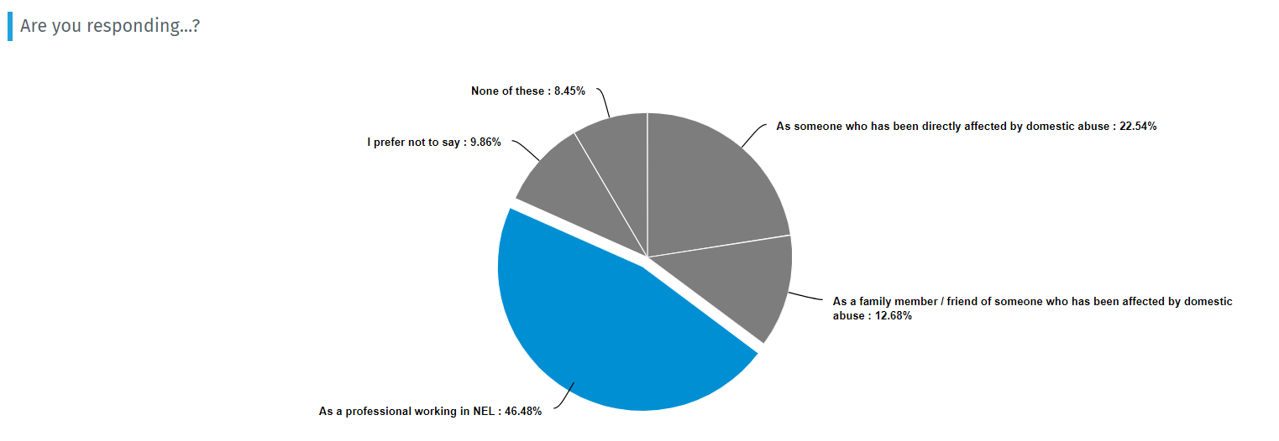
Responses cont.
The majority of people responding live and work in NEL

Slide 4
Do you believe there are enough alternative options where refuge is unsuitable for victims and their children?

Slide 5
Do you believe there is a specific need to provide accommodation for male victims?

Slide 6
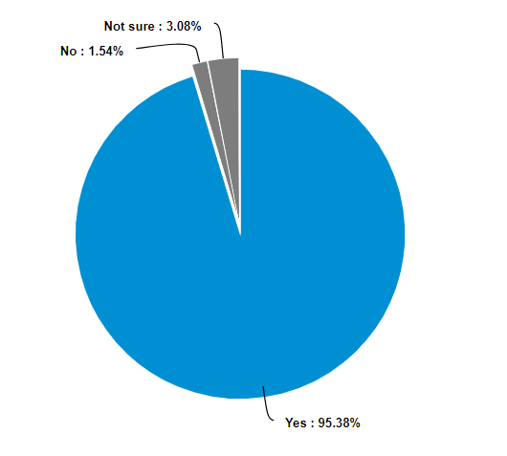
Do you believe there is a specific need to provide more specialist support for children and young people?

Slide 7
We believe refuge accommodation should be a safe space for those who need to access the specific support and accommodation that can be provided. How would you describe the NEL refuge?

Slide 8
As part of delivering the safer accommodation duty, we are considering the following options to help provide a safe offer for victims and their children. To what extent do you agree or disagree that the following options should be considered to help provide support to victims?
Question | Count | Score | Ranking
Outreach support linked to dispersed accommodation - Support delivered across communities that can be accessed when living in self-contained flats or houses in NEL | 47 | 4.28 | Strongly Agree
Resettlement accommodation with dedicated support – Specific accommodation with support for victims and their children who are ready to move on from refuge accommodation | 48 | 4.42 | Strongly Agree
Sanctuary scheme (Target Hardening with associated support) - A victim-centred initiative which aims to allow households at risk of violence to remain safely in their some by installing enhanced security measures and through the provision of support to the household | 46 | 4.09 | Agree
Complex IDVA (Independent Domestic Violence Advocates) support linked to dispersed accommodation (support linked to dispersed accommodation – Specialist support for victims of domestic abuse with additional complex needs ie housing, substance misuse and mental health, being delivered across communities that can be accessed when living in self-contained flats or houses in NEL) | 48 | 4.29 | Strongly Agree
A wider range of dispersed accommodation options (Self-contained flats, Shared Properties or houses in NEL) | 47 | 4.13 | Agree
Accessible dispersed accommodation (victims with protected characteristics) – (Self-contained flats, Shared Properties or houses in NEL that have been specifically adapted for victims and children who have additional needs and or disabilities) | 48 | 4.33 | Strongly Agree
Access to Crisis/Emergency accommodation and support (Short term accommodation and support that can be accessed by victims and their children in a time of need and emergency. This may include refuge accommodation and self–contained accommodation with aacess to support) | 48 | 4.5 | Strongly Agree

Slide 9
Do you agree or disagree that the following options should be considered to help provide support to victims?
Question | Count | Score | Ranking
Resettlement accommodation with dedicated support | 51 | 4.43 | Strongly Agree
Sanctuary scheme (Target Hardening with associated support) | 51 | 4.31 | Strongly Agree
Complex IDVA support linked to dispersed accommodation | 48 | 4.4 | Strongly Agree
A wider range of dispersed accommodation options | 49 | 4.41 | Strongly Agree
Accessible dispersed accommodation (victims with protected characteristics) | 49 | 4.41 | Strongly Agree
Outreach support linked to a dispersed accommodation model | 49 | 4.35 | Strongly Agree
Access to Crisis/Emergency accommodation and support | 51 | 4.63 | Strongly Agree
Integrated pathway to access other forms of accommodation and support where Domestic Abuse or risk of is not the primary need | 49 | 4.24 | Strongly Agree
Joint pathway to access all options, including assessment of Domestic Abuse risk and housing assessment | 47 | 4.43 | Strongly Agree

Slide 10
Do you think these will help us deliver safer accommodation in the borough? Do you agree that this is the right approach to take?

Slide 11
The strategy is set out to enable partners across the borough to work together to create safe opportunities for victims of domestic abuse and their children to access accommodation and support to meet their needs. Would you like to share any further feedback about this strategy?
if we get this right we could change the lives of many women and children. for me this is a very important piece of work and we need to focus on changing the perception that if you are a victim you need to move (however i appreciate that in some cases this is absolutely necessary but this should NOT be the norm). we need to be safeguarding the victims and children and punishing the perpetrators by working more closely with the police and solicitors to ensure that the perpetrator is held accountable for their actions. This is what i feel is currently missing. I also feel that we need more support for the children of these families as they are very clearly as much a victim as the actual victim and this is an area that i feel has been neglected.
Must be time bound with smart targets as quite often people get lost between multi agency strategies
Victims of domestic violence including children as victims should have the same housing rights as anyone else in the community. For to long they have been forced to leave their homes and go into unsuitable accommodation and run down refuges as their only option. They are treated and punished as being homeless and treated as so breaching their rights to be rehoused immediately or given priority with housing with extra support for the children. Refuges are not suitable for purpose, and this wants addressing and bringing into the 21 st century. Give all domestic violence victims the right to be rehoused without having to go into a refuge or bedsits or shared accommodation where this environment has the potential to be just as damaging and volatile to children. Children do suffer in these places when their mental health has already been given a beating. Their rights are obviously abused with rigid routines in refuges , and their freedom to some extent taken away from them. These victims should have the right to be automatically rehoused in another authority if appropriate to do so without the local authority making decisions for them and the victims waiting a long time to be given permission to relocate. This damages children's mental health as much as living with domestic violence does. How dare anyone take the victims’ rights away from them because they are not only victims but survivors of horrendous crimes against them that no one in society would accept. Stop ticking boxes to see if these victims qualify for housing and the right to live with their children in a safe environment and to live independently in an environment of their choosing. Of course they qualify! Person centred approach should be in place at all times but alas I know this is not always the case. The blue door also wants stepping up as well and offer more support than they give. Speaking from personal experience I was just as traumatised by the staff and their appalling attitude towards me there than coming out of a violent relationship and my abuser escaping punishment as I was not believed, and he was protected by the blue door. Don't punish them further than they already have been. I have written this, but I know NELC failed me and they will continue to fail others when funding, lack of resources and the New one is support is restricted due to the COVID crisis and people are working from home. Convenience for all NELC staff to save money in this deprived community will always be an issue. Thank you.
No support given to DV victim to be rehoused with children from ex partners home which he can walk into anytime not married, and left with no hot water and heating as ex no repairing boiler also local authority giving out wrong info to victims saying entitled to half the house not on mortgage not married got correct info from legal source now what does she do 4 children need rehoming

Slide 12
We welcome your views on equality and if you think there is anything further we should consider relating to equality and diversity, please add any comments below:
increase the home choice lincs housing band if the victim asks for a move because they don’t feel safe, it’s impossible to bid on another property and stand a chance because you are already housed and stuck at band 4 unless you go to a refuge
Male abuse, same sex relationship abuse and abuse in BAEM communities all have additional sensitivities and need specialist input.
Yes practice what you preach.
Accommodation in shared buildings needs to be properly risk assessed to ensure the safety of all as some victims may have their location revealed resulting in offenders attending the properties which will impact more people.
As a female, I think males need targeted support when a victim of domestic abuse with the same anonymity as female refuge centres, somewhere they can open up and not be ashamed.
Male victims with children also need support. Male domestic abuse victims. Acknowledgement that perpetrators are not always partners, but anyone victims live with. Support is needed more after refuge, when normal life resumes.
You appear to be offering too many options which I find confusing! I don't understand why it is always the women & children who have to move out when it should be the offending partner! If male partner is causing problems then he should be kicked out & restraining orders applied. Why should it always be the female & children who must move out?

Slide 13
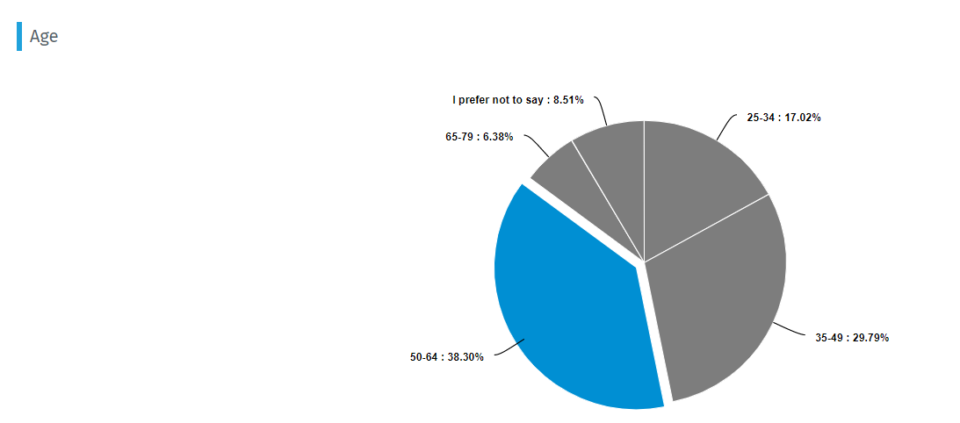
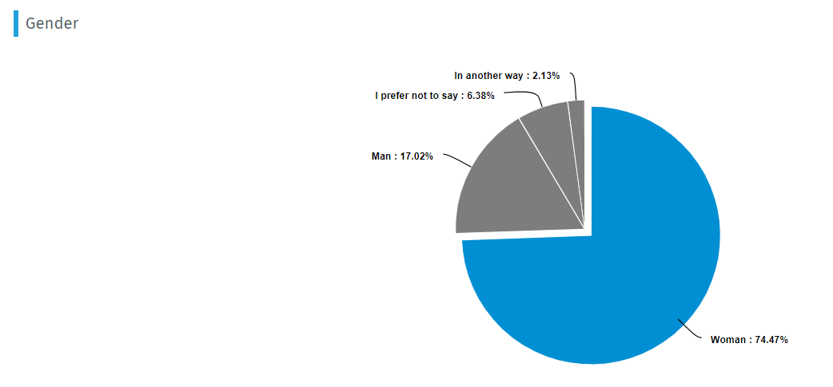
Demographics

Slide 14
Demographics cont.
Sex | Count | Percent
Straight | 39 | 82.98%
Lesbian | 1 | 2.13%
Bisexual | 2 | 4.26%
Gay | 1 | 2.13%
I prefer not to say | 4 | 8.51%
In another way | 0 | 0%
Disability | Count | Percent
No disability | 31 | 62%
Physical impairment such as difficulty moving your arms or mobility issues | 2 | 4%
Wheelchair user | 0 | 0%
Sensory impairment such as being blind or having a visual impairment | 0 | 0%
Sensory impairment such as being deaf or having a hearing impairment | 1 | 2%
Mental health condition such as depression, dementia or schizophrenia | 5 | 10%
Long-standing illness or health condition such as cancer, HIV, diabetes, chronic heart disease or epilepsy | 5 | 10%
Learning disability or difficulty (such as Down's syndrome or dyslexia) or cognitive impairment (such as autistic spectrum disorder) | 0 | 0%
I prefer not to say | 6 | 12%
Other (please specify) | 0 | 0%

Slide 15
Ward demographics

