Slide 1
Selective Licensing
Jacqui Wells
Head of Housing Strategy
Guest Speaker Linda Cobb OBE
Decent and Safe Homes (DASH)

Slide 2
Purpose of the Meeting
This event is part of the consultation on Private Rented Property in parts of the East Marsh Ward.
The online survey and supporting evidence can be found on the Council’s web site by searching on “Have your say” on Have your say now as consultation on Selective Licensing in East Marsh gets underway | NELC
Other questions can be responsed to via our email address selectivelicensing@nelincs.gov.uk
Notes:
Thank you for joining us this evening. At the moment this is a proposal and your views are important to us. Further details can be found on our website along with the full analysis. There is also an email address where questions can be raised. We do try and respond within 3 working days.

Slide 3
Housekeeping
There will be a presentation followed by a question-and-answer session
The session will take from 5.30pm to 7pm. If we finish early, officers will stay online just in case people join the meeting later.
Please put any questions in the chat function
We will only answer Landlord Questions
All other questions will be responded to via the Frequently Asked Questions page.
Please be polite, we are only human.
Notes:
Just some polite housing keeping rules for this evening. There is time at the end of the session for questions and answers. If any questions can be added to the chat. We have officers looking at these to hopefully group these in an effort to get through as many as possible. If we don’t need the full one and a half hours, officers will stay online to speak to anyone who is unable to join earlier in the meeting. Whilst we appreciate this is a controversial proposal to some of you, we would ask you to remember we are officers, who are representing the Council, and are only human. We ask you to respect this.

Slide 4
AGENDA
What is Selective Licensing
Why is the East Marsh eligible for Selective Licensing
Details of the scheme
Fees and Discounts
Licence Conditions
Timeframe
DASH – Landlord Accreditation and ‘Call B4 you Serve’ Service
Question and Answer session
Notes:
The agenda will provide you with information related to the scheme, including licence conditions and timeframe which I know some may have already asked for details.

Slide 5

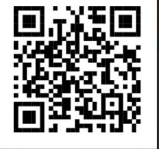
What is Selective Licensing
Notes:
We are keen to get your views, and the QR code on the

Slide 6
Existing Private Rented Licensing Scheme
Mandatory Licensing
Applies to Houses of Multiple Occupancy, with 5 or more unrelated people forming two or more households, sharing amenities for example kitchen or bathrooms.
This is a national scheme and further details of properties licensed in the borough can be found here;
HMO-register-2024-v2.pdf
Properties licensed under this scheme are exempt from Selective Licensing.
Notes:
Some of you may already hold a licence with the Council, through the House of Multiple Occupancy Licence process. We currently hold a register of over 100 licensed HMO’s in the borough and have recently made service improvements which include an online application and payment system.

Slide 7
What is Selective Licensing
A scheme designed to improve areas and regulate housing management practices.
All landlords in the designated area will require a licence for each property. There will be several conditions attached to the licence which the landlord will need to maintain. This includes condition of the property and management practices.
Penalties apply if landlords operate without a licence in these areas.
Local authorities in England and Wales have had discretion to apply these schemes since April 2006 under the Housing Act 2004.
Notes:
Selective Licensing is included in the Housing Act 2004 and the powers have been available since 2006. Several local authorities have brought in selective licensing schemes, many of which have seen improvements in the designated areas with a reduction in crime, anti-social behaviour and an increase in housing standards and management practices. The scheme allows the Council additional powers that are not available to them at the moment. For example powers of entry. Currently we have to write to landlords to before we can take formal action. This will allow us to enter a property and take action where it is appropriate.

Slide 8
Tenants
Sets standards for the management and condition of homes
Improves the health and safety of homes for tenants
Gives council’s the power to enforce against landlords that do not meet licence conditions.
Notes:
The benefits for tenants are:

Slide 9
Landlords
Creates a level playing field so decent landlords are not undercut
Poorly performing landlords can receive support and training
Improved reputation of the private rented sector
Support is provided to landlords dealing with problem tenants
Notes:
The benefits for landlords are:

Slide 10
Residents
Improved community cohesion
Better tenancy management helping tenants to stay in a property longer, giving an opportunity to build communities
Confidence that tenants living in privately rented property causing/connected to anti-social behaviour is managed.
Notes:
The benefits for all residents are:

Slide 11
Why the east marsh?

Slide 12
Eligible Criteria
The Council have powers to introduce selective licensing of privately rented homes to tackle problems in their areas, or any part or parts of them caused by;
low housing demand (or is likely to become such an area) and/or
a significant and persistent problem caused by anti-social behaviour
poor housing conditions
high levels of migration
high level of deprivation
high levels of crime.
Notes:
To be eligible for the scheme, the area need to have evidence of the following criteria. We looked at each however did not have sufficient data around migration. Migration is not necessarily about immigration, it includes migration in and around the borough. Just as a side note, we are currently looking at our Homelessness and Rough Sleeper Strategy, which you will be consulted on – again your comments and feedback would be useful. According to our records, a high percentage of homelessness applications originate from the East Marsh area.

Slide 13
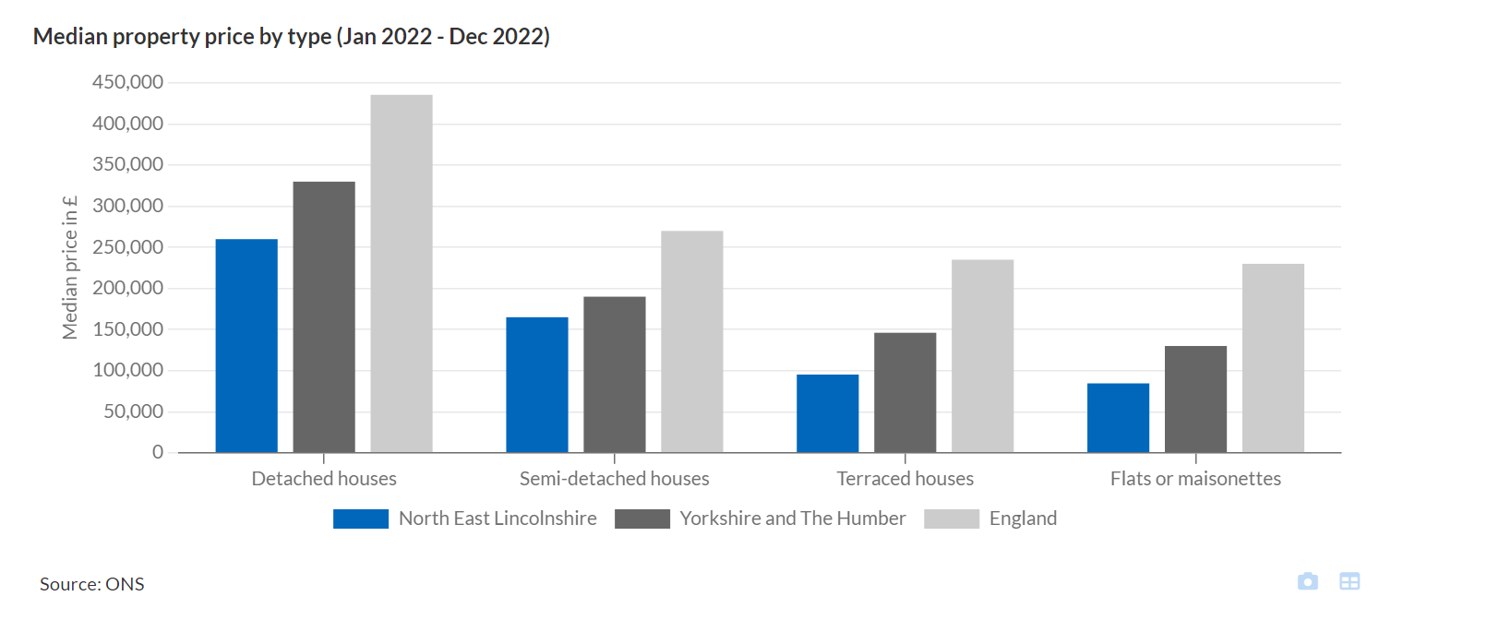
Low Housing Demand
The area has lower properties values than in other areas of the borough. The average value for this area is around £43,000. The median terrace house price for the borough is £95.250, whereas in the Yorkshire and Humber it’s £146,100.
Notes:
There is low demand in the area, this is reflected in the average property price, which is higher in other areas of the borough.

Slide 14
Other considerations
High levels of empty homes
Length of time to sell a property

Slide 15
Property Conditions
Highest level of complaints in the East Marsh.
Notes:
The map is a heat map showing where most of the housing enforcement cases are received. As you can see the darker red indicates the higher levels of complaints received where tenants have reported disrepair. The other areas include parts of the Sidney Sussex, Hainton and Heneage areas. These are included in our Areas for Action campaign, details of which will follow in the future.

Slide 16
Effects of Living in a Cold Home
Living in a cold home can contribute towards poor health.
It can contribute towards condensation in the home.
Higher energy bills/or unable to afford to put the heating on.
Affects mental health.
Notes:
Many properties in the East Marsh are pre 1919 terrace houses with poor energy performance levels. It costs more than your average home to heat. Homes in disrepair can often be more expensive to heat if there is poor thermal insulation, windows doors and an inefficient boiler make heating a home often unaffordable, especially if rents are high.

Slide 17
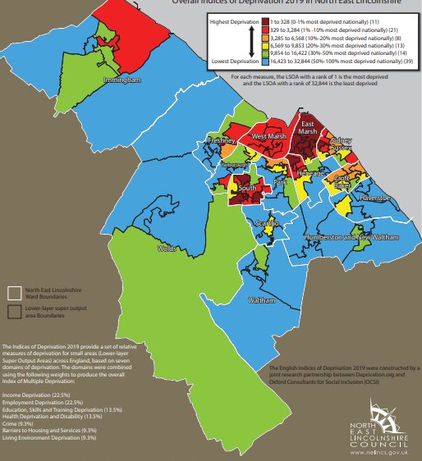
Deprivation
The East Marsh area is ranked 25 out of 32,844 in England. This is broken down further by income, employment,, health, education, barriers to services, living environment, and crime.
Notes:
The area is one of the most deprived in England. We’ve broken this down to further;

Slide 18
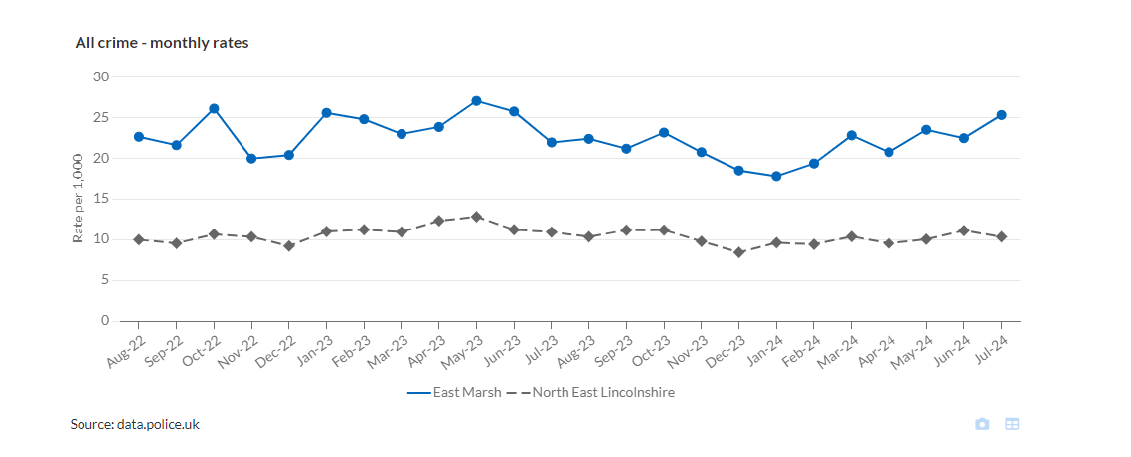
Crime
Crime is above average.
Notes:
These figures were provided by the Police and show that levels of crime in the East Marsh, are continually higher than the average throughout the rest of the borough.

Slide 19
Anti-Social Behaviour
The area has higher levels of anti-social behaviour than in other wards.
Notes:
As you can see, the East Marsh had the most incidents of Anti-social behaviour, in comparison with other wards. The East Marsh had 379 reported incidents, where as the West Marsh had 331.

Slide 20
Environmental Crime
Nearly half of all fly tipping incidents are in the East Marsh area.
Notes:
Over the last three years, almost half of the fly tipping incidents were in the East Marsh area. These figures do not include rubbish in alleyways. Residents regularly feedback that they are unhappy that alleyways are piled high with rubbish, and they must leave their bins outside on the street. These often get blown or knocked over littering rubbish into the street. Keeping alley ways clear can mean residents keep bins at the back of their houses, removing them from the street so it’s easier for prams and wheelchairs to access the footpath.

Slide 21
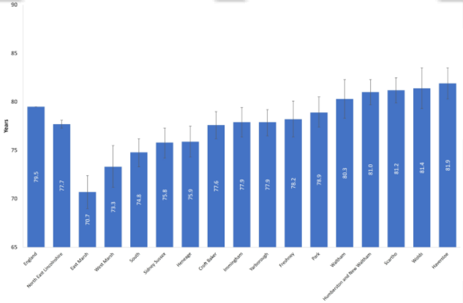
Health Inequalities
Life expectancy in the East Marsh is much lower than in other wards.
Male from Birth
77.7 years in North East Lincolnshire
81.9 years in Humberstone
70.7 years in the East Marsh
Female from Birth
82.1 years in North East Lincolnshire
86.3 years in Humberstone
75.9 years in the East Marsh.
Notes:
People living in the East Marsh are likely to live a much shorter life than other areas of the borough, including neighbouring areas such as Sidney Sussex, which is essentially across the road.

Slide 22
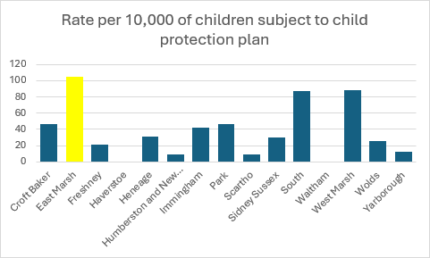
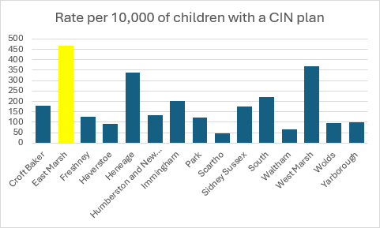
Children Services
Children in the East Marsh are more likely to require assistance from Children Services

Slide 23
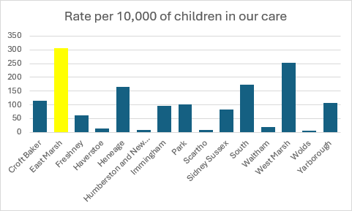
Children in our Care
Children in the East Marsh are more likely to end up in Care
Notes:
Children are more likely to end up in Care in the East Marsh. This amount is much higher than other areas.

Slide 24
Details of the scheme

Slide 25
Details of the scheme
The proposed scheme will impact on around 3961 properties – around 38% of these will be privately rented and require a licence.
We anticipate that this figure will be higher.
Notes:
There are around 4,000 properties included in the scheme. This includes social rents, owner occupiers and privately rented. The 38% includes the whole of the East Marsh, which has a higher level of social rented property. Therefore we anticipate a higher level of privately rented properties in the designated area. We are unable to get a more a more accurate figure however if it is higher, then this could affect the licence fee. The Council cannot make a profit from the scheme, it has to be delivered at nil cost to the Council.

Slide 26
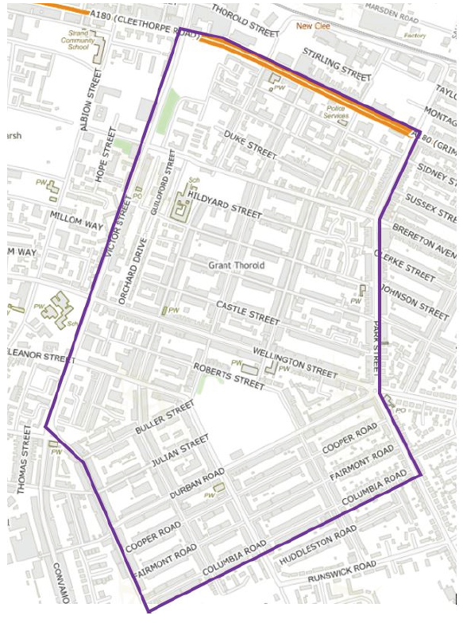
Notes:
The map shows the proposed designated area. If you feel that areas should be included, or omitted, please comment on this in the survey. Where you have roads where we have a query over which side of the road is included – the area included is the side of the road that is nearest to the area. For example; Park Street is the area in the East Marsh and not the opposite side of the road which is in Sidney Sussex. Victor Street is the side on your left hand side coming from Cleethorpe Road. And Cleethorpe Road is the side on your right hand side as you come over the fly over.

Slide 27
Licence Fee
The licence fee is proposed to be in the region of;
£899 - £1,284.
This works out as £3.45 - £4.93 per week
The proposal allows for an:
Early Bird Discount
Discount for being a member of a recognised Landlord Accreditation Scheme
Multiple property discount
Being a Registered Charitable Housing Organisation.
Fees are a one off payment for a 5 year period.
Where properties are sold and licences required for new landlords.
If properties are sold, the new landlord will be required to apply for a new licence.
Notes:
The proposal includes discounts which can be added on top of each other. For example; a landlord will multiple properties can also gain an additional discount for an early bid application. It is important to note that the licence fee is per 5 years. There are no current plans to extend this. An additional period would depend on how successful the scheme was and if it was considered it needed to be extended after an evaluation process.

Slide 28
What will the fee be spent on?
Costs include the following;
Additional staffed team at an appropriate level
Overheads including licence fees for database
Scheme set up costs including ICT, phones.
Administration costs (postage etc)
THE SCHEME MUST BE DELIVERED AT NIL COST TO THE COUNCIL, WHO MUST NOT MAKE A PROFIT.
Notes:
These are suggested fees and may be open to change. We are here to listen to your feedback. The figures have been worked out using a methodology used by other local authorities who are successfully delivering similar schemes. It includes an additional team including; administration officers, housing officers and management team.

Slide 29
Licence conditions
Licence conditions could include the following requirements;
Gas safety Certificate
Safety of electrical appliances,
Installation of smoke alarms/ fire detection systems
Carbon monoxide alarms
Property management (repair and maintenance, external areas clear/ tidy)
Deal with rubbish and waste (provide waste disposal certificates upon request)
Evidence of Tenancy management practices
Evidence of how a landlord will tackle Anti-Social Behaviour
Energy Performance Certificate
Electrical Certificate (EHICR)
Tenant Referencing
Notes:
The conditions don’t ask for additionality, for example an improved energy performance certificate, over and above the legislative standards. These conditions include general good practice and upkeep of them and their tenants obligations to the neighbourhood.

Slide 30
Removing fly tipping and waste bins from the streets
Notes:
Fly tipping is a big issue in the area. These photos were taken by a colleague and show that some of the rubbish isn’t due to tenants entirely. The photo’s also show bins out on the streets. It is the schemes ambition to get these to the rear of the properties, with access to gardens via cleared alley ways.

Slide 31
Benefits of Selective Licensing
Our research showed that other areas have seen areas improve, where a selective licensing scheme has been designated.
Improved Housing Conditions
Reduced Fly Tipping/ASB
Reduced Crime
People living in properties longer.

Slide 32
Timeframe
Pending Approval
Consultation minimum 10 weeks
January 2025
Assess consultation feedback. Make necessary changes and present to Scrutiny
April / June
Final proposition presented to Full Council with recommendations.
July 2025
Subject to Full Council approval – Issue a Notice of Designation
August 2025
Winter 2025/26
Pending Approval, the scheme will commence Winter 2025/26.
3 month cool off period

Slide 33
Please welcome Linda Cobb OBE
from Decent and Safe Homes (DASH) to talk about DASH, what they do, landlord accreditation and Call B4 You Serve.

Slide 34

Any questions?

