Slide 1
Joint Scrutiny Session
Housing
^{7th October 2025}

Slide 2
OVERVIEW

Slide 3
Challenges regarding the Housing Market
Recent demolition of 900 houses in the last 10years (Home options report) adding to the lack of supply
Total of 2,819 empty homes, 1,348 of which have been over six months (data from 3rd October 2021) (Housing strategy)
Only 9.4% of NELC’s housing stock has been built post-2000 (Housing Strategy)
There is a high demand for 1-bed properties (51.4% of applicants on the housing register), however only 8.4% of homes in NELC are one bed (NELC joint strategic needs assessment and Housing Strategy)

Slide 4
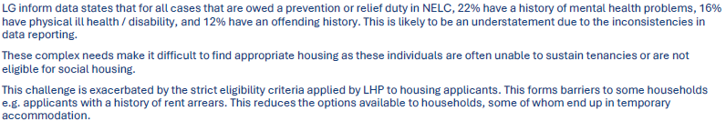
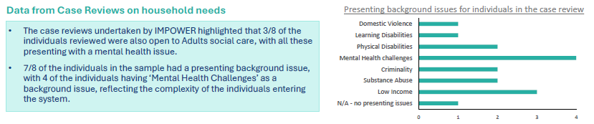
Many households have multiple and complex needs

Slide 5
A quarter of housing applicants return at least once
The homelessness strategy data captures 4,484 applicants between 2019 and 2024
Overall, 23% of applicants returned at least once
Applicants who were owed relief duty initially were most likely to return, with 28% making at least one more application. Applicants owed neither duty were also more likely to return (25%)

Slide 6
60% of households assessed for prevention, relief or homeless duty have underlying support needs
Demand for housing, especially affordable 1-bed properties, significantly out-strips supply.
According to the most recent nationally available data, NELC completed 16% more housing needs assessments than the statistical neighbour average

Slide 7
Data and Demand

Slide 8
Housing Register Data
 | 1 bed | 2 bed | 3 bed | 4 bed | 5+ bed
Band 1 | 119 | 94 | 56 | 20 | 1
Band 2 | 139 | 89 | 44 | 41 | 41
Band 3 | 108 | 187 | 207 | 221 | 22
Band 4 | 3710 | 1758 | 887 | 69 | 7

Slide 9
Temporary Accommodation
Temporary accommodation
B&B | 22
Crisis accommodation | 45
Temporary Accomodation | Numbers
Total | 67
Casework | Numbers
Triage | 202
Prevention | 138
Relief | 192
Main | 23

Slide 10
Rough sleeping

Slide 11
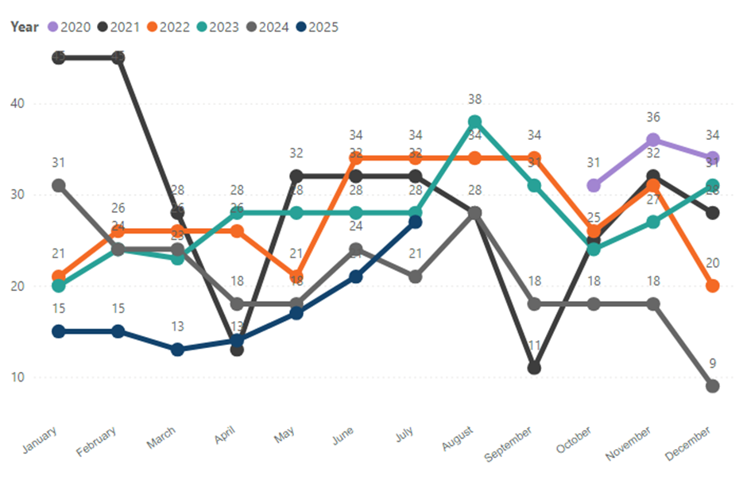
Fig 1. Number of rough sleepers over the month, broken down by year
Current numbers of rough sleepers = average 8 per week
21 individuals per month reporting as rough sleeping
Target priority group (TPG) number is 20 individuals who are at risk of falling into rough sleeping or currently rough sleeping

Slide 12
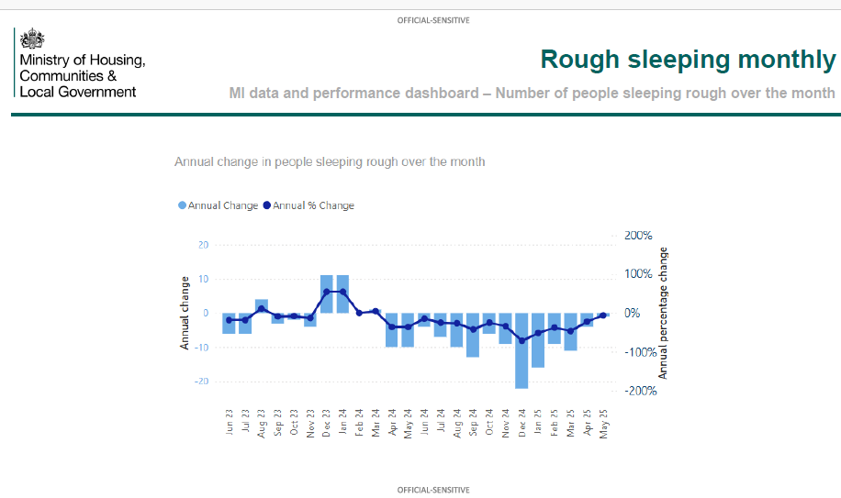
Rough sleeping monthly

Slide 13
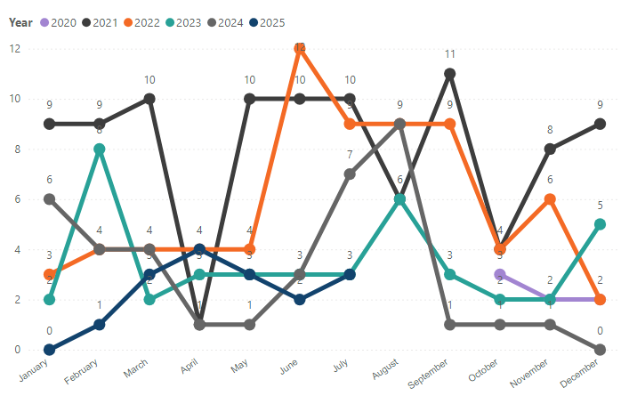
Long-term rough sleepers
Fig. 2 Number of long -term who are sleeping rough by year
3 rough sleepers no accommodation options a reduction from 9 in 2024

Slide 14
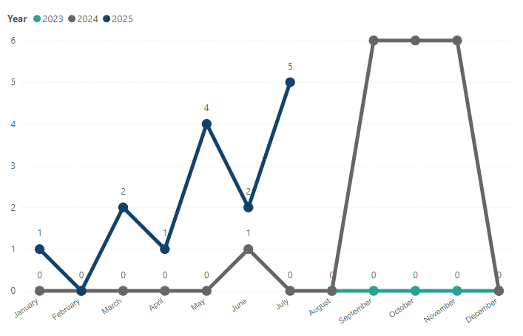
  Returning to rough sleeping
Fig 3. Number of returners to rough sleeping by year

Slide 15
New to rough sleeping
This number remains consistently low at around 3. There are several options for those who find themselves homeless, utilising Harbour Place and our commissioned providers

Slide 16
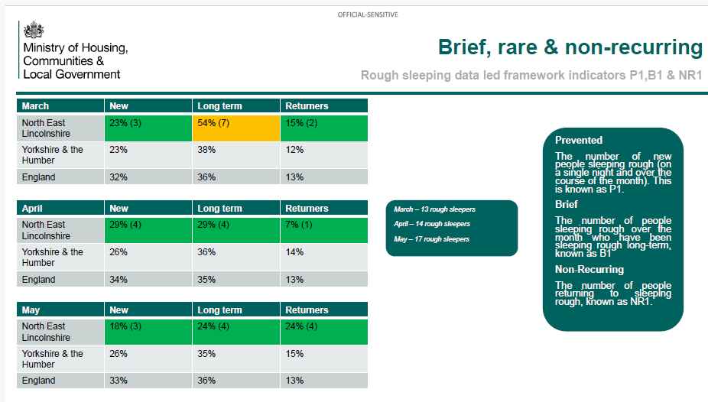
Brief, rare & non-recurring

Slide 17
Swan House – single homelessness accommodation
Rough sleeping units | 14
Move on accommodation | 13
Support provided by Humber Care, We Are With You and Navigo
Vacancies filled by people in the target priority group

Slide 18
policies

Slide 19
POLICIES & COMMISSIONING PIPELINE
Marmot
Homelessness and Rough Sleeping Strategy
Homelessness and financial assistance policy
Housing related support re commissioning
Affordable housing Strategy

Slide 20
actions

Slide 21
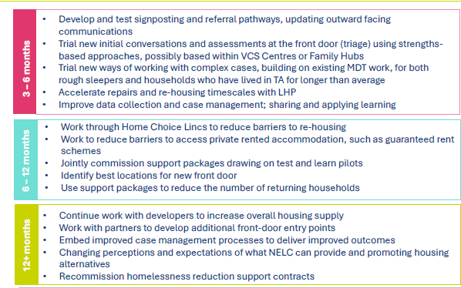
Workplan

Slide 22

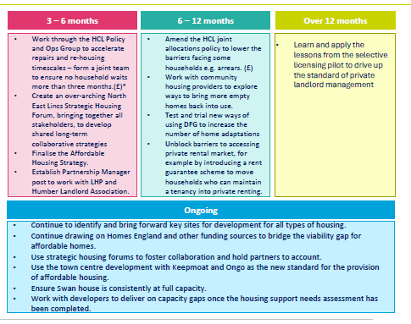
Priority 1

Slide 23
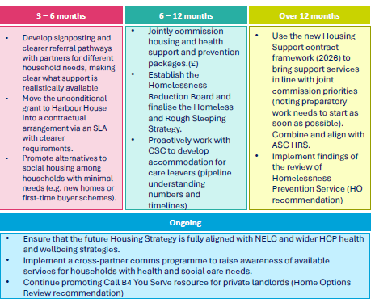
Priority 2

Slide 24
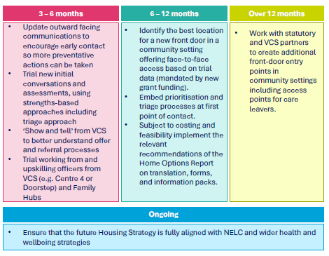
Priority 3

Slide 25
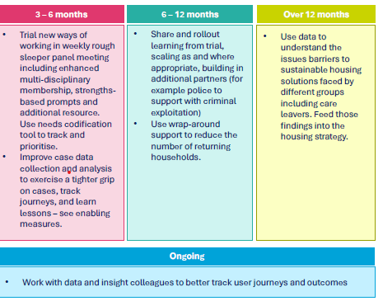
Priority 4

Slide 26
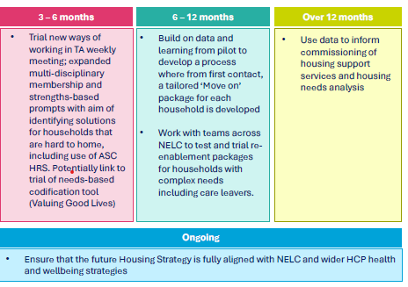
Priority 5

Slide 27
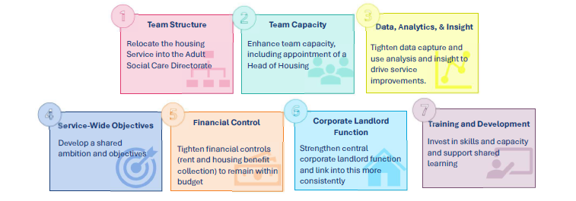
Enabling measures

Slide 28
Partnerships
Public Health - Marmot
Safe Homes – Neighbourhood Plan for Towns (community led housing)
Empty Homes
Social housing providers
Private sector landlords
Neighbourhood Health

Slide 29
UK Affordable Housing Policy 2026–2036
5 Key Priorities
1. Boost Grant Funding: Deliver the biggest increase in housing grant funding to support social rent homes (60%).
2. Rebuild Sector Capacity: Enable councils and housing associations to borrow and invest in new and existing homes.
3. Establish Stable Regulation: Create a consistent and effective regulatory regime to ensure quality and accountability.
4. Reinvigorate Council Housebuilding: Encourage local authorities to build homes at scale, reversing decades of underinvestment.
5. Forge Strategic Partnerships: Collaborate with housing associations, developers, and councils to deliver affordable homes efficiently.

Slide 30
Key legislation
Renters Rights Bill
Abolishing Section 21 “no fault” evictions and assured shorthold tenancies.
Replaced by periodic tenancies.
Tenants can give two months’ notice at any time, and there is no minimum tenancy term
Extending minimum electrical safety standards to the social rented sector (from November 2025, if approved).
Reforms to social housing allocations, making it easier for domestic abuse survivors and care leavers to access housing
Rent increases are limited to once per year, and tenants can challenge above-market or unfair rent rises through a tribunal
Right to request pets
Rent increases are limited to once per year, and tenants can challenge above-market or unfair rent rises through a tribunal
A new ombudsman will provide free, binding dispute resolution for tenants’ complaints about landlords
  .Private Rented Sector Database
  All landlords must register their properties on a new national database (the “Rented Property Portal

Slide 31
Key legislation cont…
Decent Homes standard (consultation ended September 2025)
The Decent Homes Standard will apply to the private rented sector, setting minimum standards for property condition
Awaab’s Law
Landlords must address serious hazards (such as damp and mould) within strict timeframes
Social housing and homelessness
From July 2025, domestic abuse survivors and care leavers under 25 are now exempt from local connection or residence requirements in local authority allocation schemes. This means they can access social housing more easily, regardless of where they have lived previously
Energy and efficiency
The government is proposing to raise the minimum standard for privately rented homes from the current EPC (Energy Performance Certificate) rating of E to EPC C by 2030.

