Slide 1
Energy & Carbon Workshop Turning the Curve

Slide 2
Councillor Watson
Deputy Leader of the Council and
Portfolio Holder for Energy and the Environment

Slide 3
Energy & Carbon Workshop Turning the Curve Welcome
Tony Neul
Strategic Commissioning Lead

Slide 4
Agenda
Speakers
Session 1
Session 2
Refreshments Break
Feedback & Close
Networking & Lunch

Slide 5
Why Energy? Context & Challenges
Offshore Wind – bright future
Legacy – onshore in slipstream
National Energy Policy – is it clear?
Price volatility – bad for business
Security of supply – local is good
Fuel Poverty

Slide 6
Council response to the challenges
Establishing a clear Vision
Stakeholder engagement
Reshaping roles – Portfolio Holder and project sponsor , commissioning lead, building on partnerships
Commitment – Energy and Carbon key commissioning project
Strategic Partnership - ENGIE
Establishing an ESCO (Local Partnerships)

Slide 7
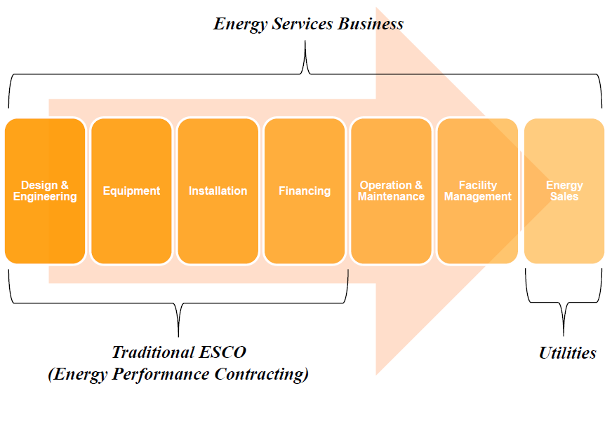
Source: IEA 2014

Slide 8
Vision and ambition
By 2032, North East Lincolnshire will be nationally and internationally recognised as the UK’s leading region for low-carbon energy and the UK capital of the renewable energy industry.
North East Lincolnshire will have developed a range of low-carbon, high-efficiency, renewable solutions to regenerate the region. This will deliver strategic and economic advantage for its businesses and affordable heat and power for its communities.
The region’s energy programme will have enough impetus that by 2050 North East Lincolnshire will not only be able to achieve its 80% carbon reduction target but will also be able to declare itself carbon neutral.

Slide 9
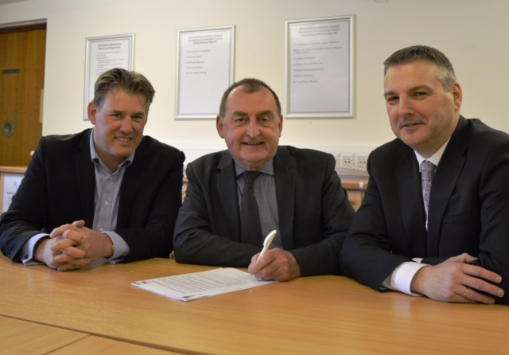
NEL Commitment Climate local

Slide 10
Council priorities are clear....
“stronger economy and stronger communities”
taking an “Outcome based approach”
“Energy” is a commissioning priority for the Council

Slide 11
Council Outcome Framework
All people benefit from sustainable communities : Our community generates less carbon and benefits from energy efficiency
% energy generated or supplied from renewable sources
Dedicated walking & cycling routes
Air quality/CO2 emissions
All enjoy health and well being : Reducing fuel poverty
All enjoy & benefit from a strong economy:
% of local businesses able to recruit suitable employees% of employees with NEL post code

Slide 12
Further progress
Reducing consumption across Council’s estate – energy conservation measures, solar PV , electric vehicles.....
Reducing cost – energy basket
Reducing fuel poverty – new scheme
Exploring Heat Networks – HNDU funding

Slide 13
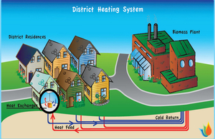
Heat Networks
Heat Mapping & Energy Master-planning – completed by May 2017

Slide 14
Community response to the challenges
Growing offshore sector & support industries (GRP)
Community solutions
Grimsby Community Energy
Get hooked on positive activities (GHOPA)
Humberston Hub +
And more.......

Slide 15
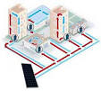
£
£
Social Investment
Commercial Investment
?

Slide 16
£
£
Social Investment
Commercial Investment
?
Economic Interest
Stronger Economy

Slide 17
£
£
Social Investment
Commercial Investment
?
Community Interest
Economic Interest
Stronger Communities
Stronger Economy

Slide 18
SUMMARY Purpose of today
Begin to get a consensus on our vision & translate it into actions
Identify Climate Local commitments (actions)
Begin to translate the Councils outcomes/priority into action

Slide 19
The workshop session
Outcome Based Accountability

Slide 20
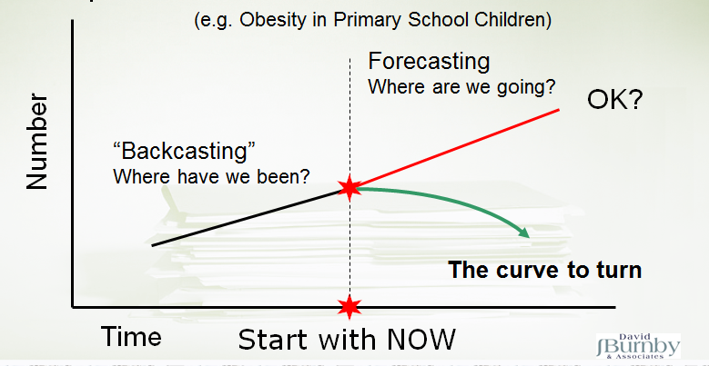
OBA

Slide 21
National and Local data and context
Matt Cooper
Channel Development Director, Engie

Slide 22
North East Lincolnshire Council
Energy and Carbon Workshop
Matthew Cooper
Channel Development Director

Slide 23
What is the rationale behind Climate Local and the move to Decarbonisation?

Slide 24
Focus on buildings CCC 2030 Central Scenario
Heat pumps and biomass, non-domestic
Newbuild heat pumps
Domestic energy efficiency
7%
7%
26%
Heat pumps & biomass, domestic retrofit
22 MtCO₂e abatement is most cost effectively achieved through a mixed technology strategy
14%
16%
21%
District heating, non-domestic
10%
Non-domestic energy efficiency
2030
District heating, domestic

Slide 25
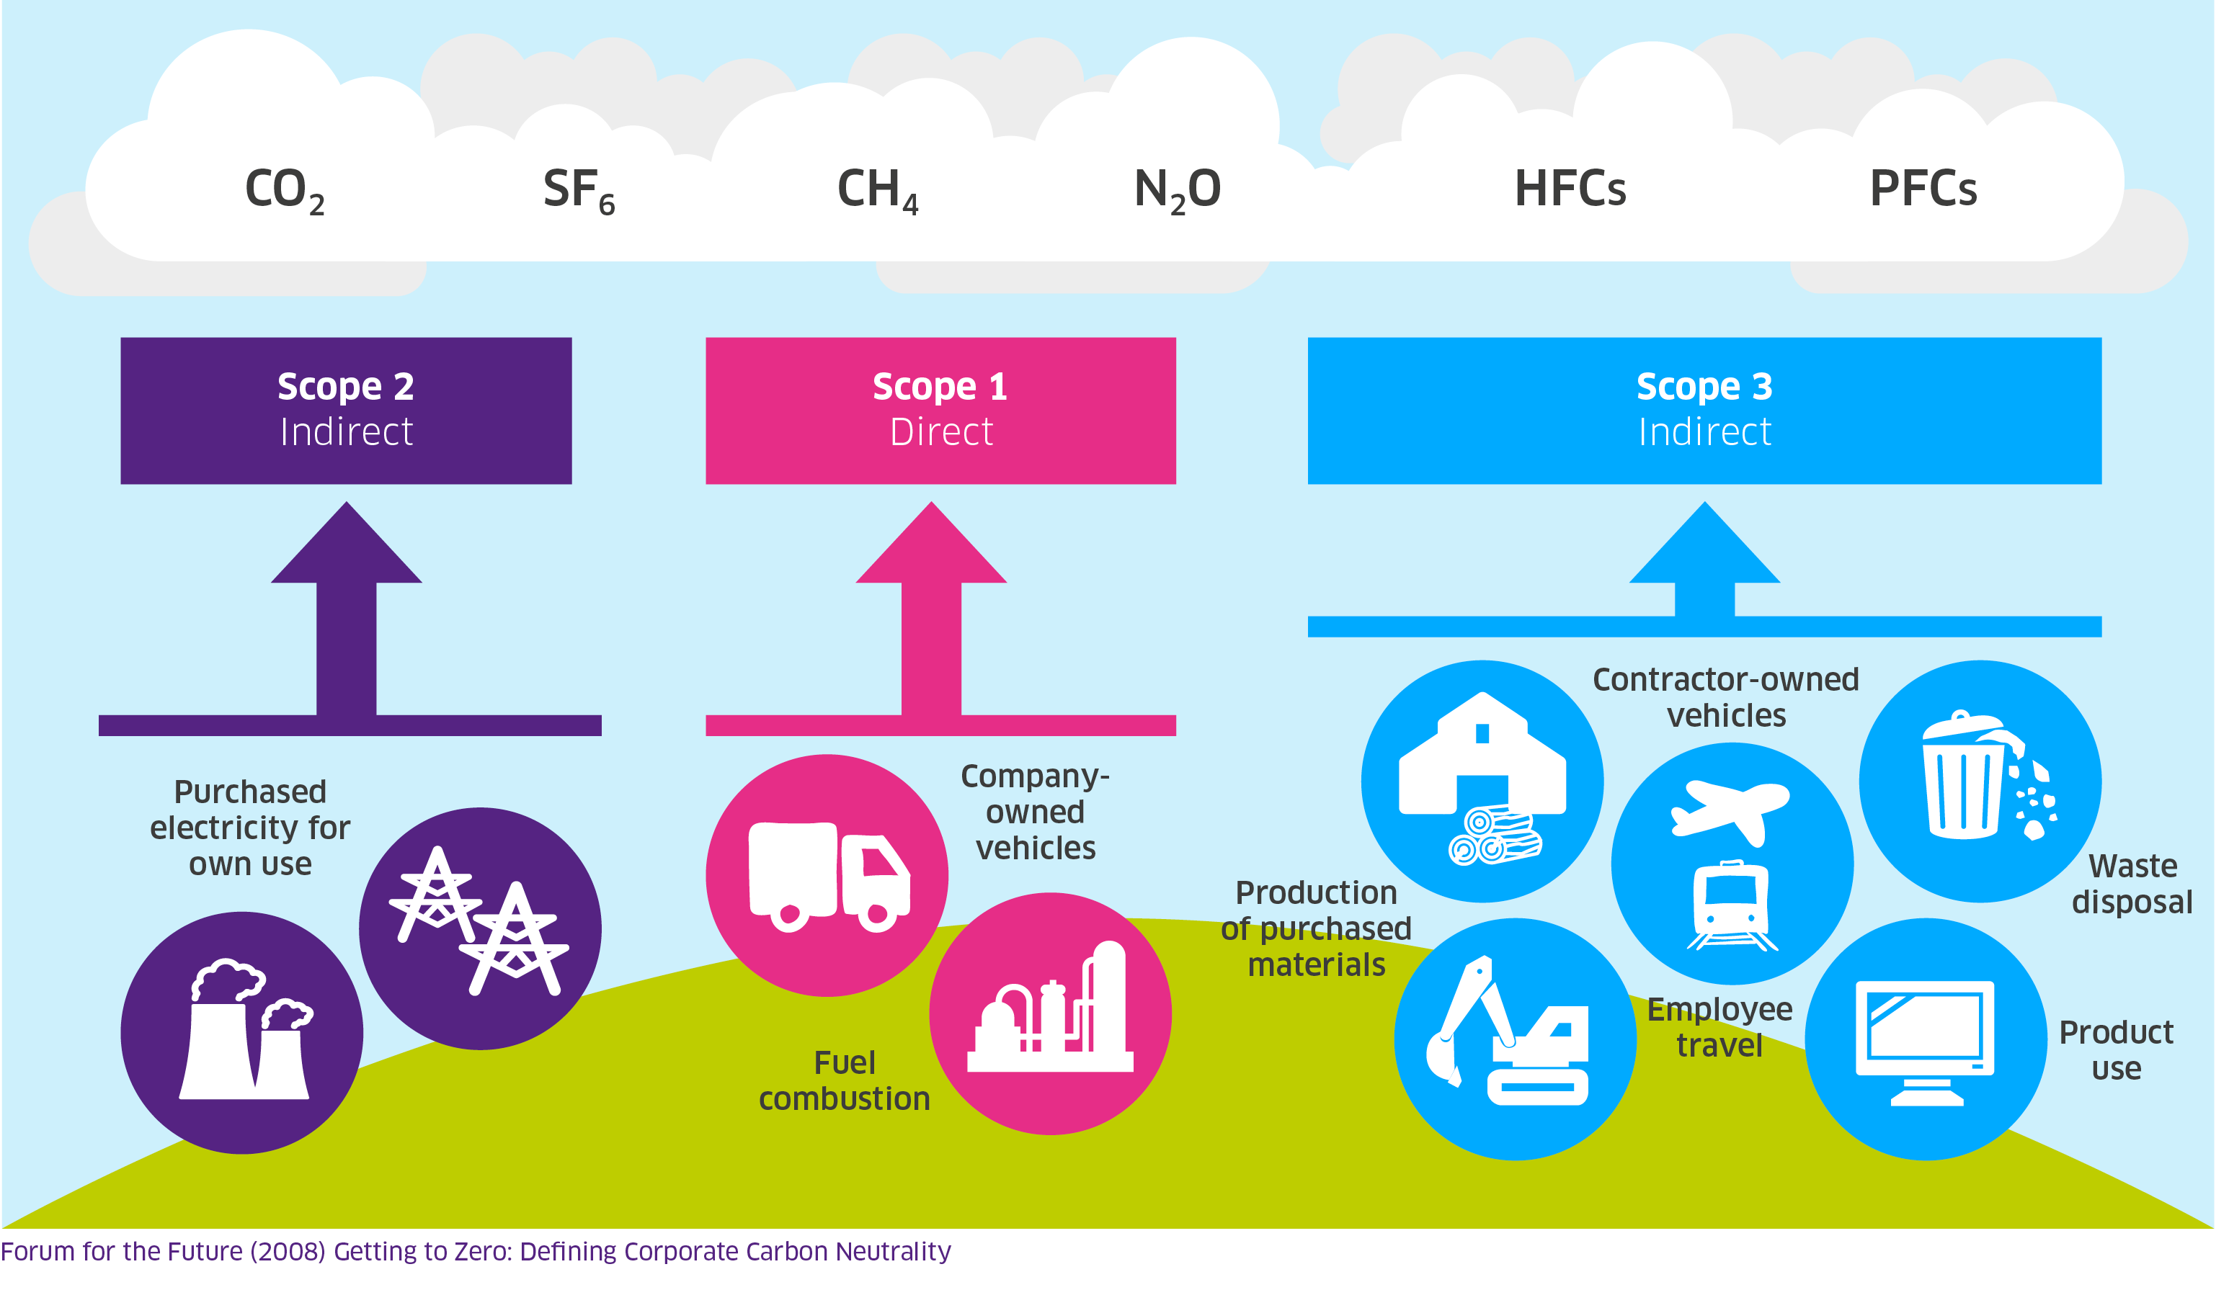
Decarbonisation – Beyond CRCEES

Slide 26
What is Climate Local?

Slide 27
What is Climate Local?

Slide 28
Climate Local supports local authorities in the following ways:
Provides a platform owned and led by councils, to promote activity on climate change and demonstrate leadership locally and nationally.
Supports local authorities to share good practice and identify other authorities undertaking similar initiatives, to support joint working and the sharing of experience and ideas.
Provides practical tools and advice to councils on climate change issues.
Raises the profile of carbon reduction and adaptation nationally.

Slide 29
Climate Local – Analysis of Existing Plans
Overarching themes of the program
Low Carbon Pathways
Climate Resilience

Slide 30
Climate Local – Low Carbon Pathways

Slide 31
Climate Local – Climate Resilience

Slide 32
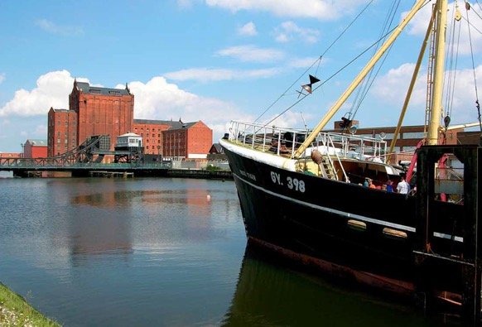
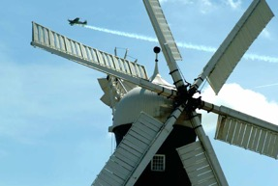
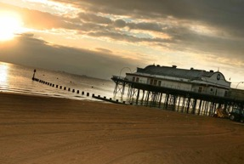
North East Lincolnshire Council
By 2032, UK’s leading region for low-carbon energy and the UK capital of the renewable energy industry.
Deliver strategic and economic advantage for its businesses and affordable heat and power for its communities.
Carbon Neutral Borough by 2050.

Slide 33
Where are we now?
Notes:
Over the last 10 years the North East of the Country has generally faired pretty well on the surface, however some signs indicate that the majority of the fall in

Slide 34
Electricity Consumption in 2014*
*Source DECC – Sub-national electricity sales and numbers of customers 2005 - 2014

Slide 35
Economy 7?

Slide 36
Non Domestic Power Consumption
Business in NELC consumes between 400-600 GWh on most recent data
Ranks in as one of the high consuming areas for Power in the UK

Slide 37
Non Domestic Gas Consumption
NEL non Domestic Gas Consumption is greater that 600 GWh
Ranks one of the highest in the UK

Slide 38
Average Domestic
Power Consumption
Average Power consumption in Domestic areas is in the region of 3500 – 3750 KWh per household
Sits as one of the lowest areas in the UK
Not necessarily an indicator of good behaviour

Slide 39
Average Domestic
Gas Consumption
Average Gas consumption in Domestic areas is less than 12,500 KWh per household
Sits as one of the lowest areas in the UK
Maybe suggestive of people not using Gas to heat their homes but using immersion heaters for example

Slide 40
Summary for North East Lincolnshire
High Power & Gas usage in Non-Domestic Properties
Heavy energy intensive industry at the core of the Borough
High Requirement going forward if regeneration plans are successful
Low Carbon approach essential for competitiveness
High Level of resilience needed for the area

Slide 41
Summary for North East Lincolnshire (cont)
Low Power and even lower Gas usage in domestic properties
Strong indication that electricity is still the dominant form of heating in the area, possibly due to its levels of poverty, using an immersion heater instead of a boiler?
Low take up of technology
Need to look further at gas as a lower carbon solution or replace with renewables
Encouragement needed for Economy 7

Slide 42
Introduction to Local Partnerships
Robert McKinnon, Local Partnerships

Slide 43
Development of the Council Owned delivery vehicle (ESCo)
Investigating the potential opportunities, business models, roles and risks for the creation of the company.
Overview of the project
High level Energy Review/ Mapped data
Support the Council with a Prior Market Consultation (PMC) exercise
Develop an Options Appraisal paper for Project’s development
Next steps - High Level Energy Review
Talk to key contacts
Test the understanding of our findings
Clarify existing plans against the NE Lincolnshire’s Local Plan

Slide 44
Table Activities
Helen Norris,
Commissioning and Relationship Manager, NELC

Slide 45
Group Activity 1 – 30 minutes
What works well now and what evidence do we have of this?
Using the data packs provided on tables and any additional information that you have brought with you, identify what currently works well in relation to the themes and indicators discussed, and how this can be evidenced.
Please use the flipchart and pens provided to capture your thinking.

Slide 46
Group Activity 2 – 40 minutes
What action could we take and with whom?
In your groups, identify ideas of actions that could be taken to improve performance in relation to the themes discussed
Identify who you would need to work with.
This should include identifying no cost/low cost and an ‘off the wall’ solutions and the ‘greatest idea’ with timescales.

Slide 47
15 minute Refreshment Break

Slide 48
Group feedback session

Slide 49
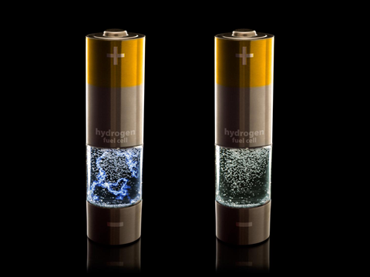
The greatest idea of them all..

Slide 50
Next Steps
Information collated and shared
Other conversations planned with ward councillors , other partners any others identified from this morning.
Information used e.g. as part of Energy and Carbon project ;Ideas developed into climate local commitment action plan and strategy development
Behaviour change , education and awareness legacy of project .

Slide 51
Closing Remarks
Councillor Watson
Deputy Leader of the Council and
Portfolio Holder for Energy and the Environment

